Slide 1
PWSH, VSCode, GitHub Copilot
Tips for the Lazy Admin

Slide 2
Attention
MMS sessions are 60-75 minutes followed by LONG Q&A
Please hold detailed questions until that Q&A starts
Feel free to ask clarification questions
Remind the speakers to use Zoom It when you can’t see

Slide 3






Gary Blok
Carl Johan Hederoth
Engineer @ 2Pint Software
Software Engineer @ 2Pint
gwblok
in/garyblok

Slide 4
Agenda
Fine Print
Dev Machine Setup
Leveraging Community Content
Creating Scripts with Copilot
Scripting for proprietary software (OEMs / Vendors)
Q/A

Slide 5
Fine Print
Have a test environment! Ideally:
Separate Network
DNS / DHCP
Replicate Prod as close as possible
CM Lab | Azure Dev Tenant

Slide 6
Dev Machine Setup
Software Basic

Slide 7
Dev Machine Setup
Git
GitHub CLI
Copilot CLI
VSCode
PS7
Set Git Username / Email
Connect VSCode to Copilot | GitHub

Slide 8
Dev Machine Setup DEMO
Software Basic

Slide 9
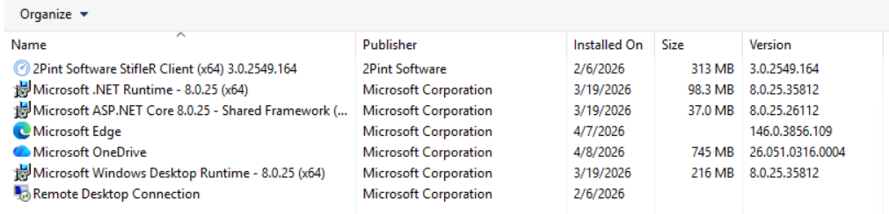
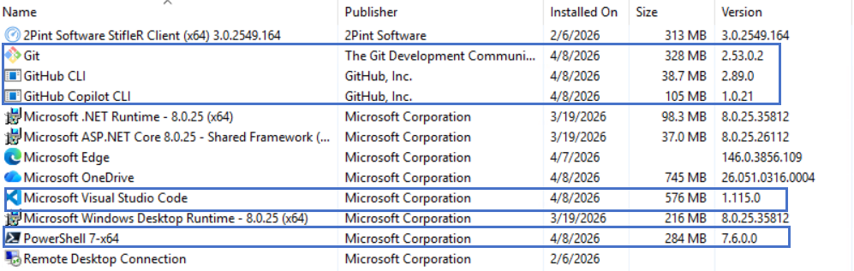
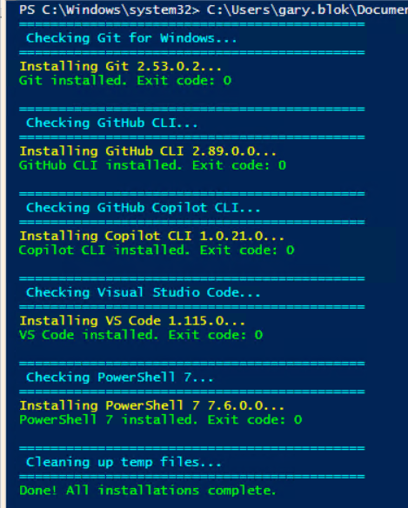
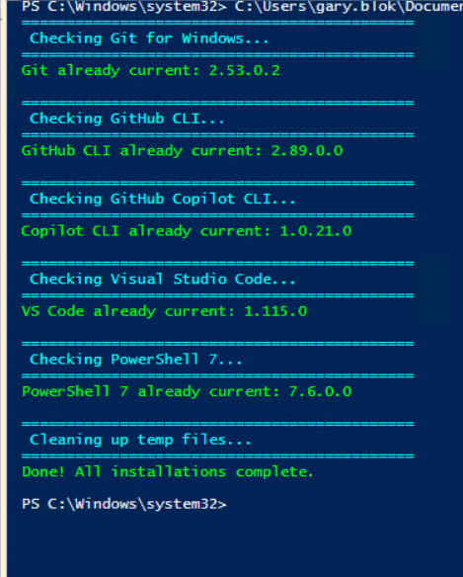
Using Script to Install Dev Apps Script created with 3 prompts:
1st Prompt:
Create a script that will install the latest versions of Git
GitHub CLI
Copilot CLI
Visual Studio Code
PowerShell 7
Using MSI files
GitHub CLI info: https://github.com/cli/cli/releases/
Copilot Release: https://github.com/github/copilot-cli/releases
Scripts that might help:
https://github.com/gwblok/garytown/blob/master/Intune/Install-Git.ps1
https://github.com/gwblok/garytown/blob/master/Intune/Install-VSCode.ps1
https://github.com/gwblok/garytown/blob/master/Intune/Install-PowerShellMSI.ps1
2nd Prompt:
What went wrong there? Can you fix it?
(Attached Screen Capture of the error)
3rd Prompt:
It says it is installing 2.53.0.0 BUT it actually installed 2.53.0.2, so you're getting the wrong version from somewhere and it re-installs GIT each time. Can you fix that? Result: MMS/2026-MOA/GitHubCopilotSetup.ps1 at main · gwblok/MMS

Slide 10
GitHub – The price is right!
Because it’s free, I don’t like paying for stuff, I got 9 kids to feed. Don’t even get me started on property taxes.

Slide 11
GitHub Overview

Slide 12
So I have this setup.. Now what???
Just start doing your normal tasks, but talk it through with the agent..
Don’t look for extra projects, It really doesn’t catch on until you use it in your daily processes

Slide 13
Creating BIOS Settings Script
According to Brian

Slide 14
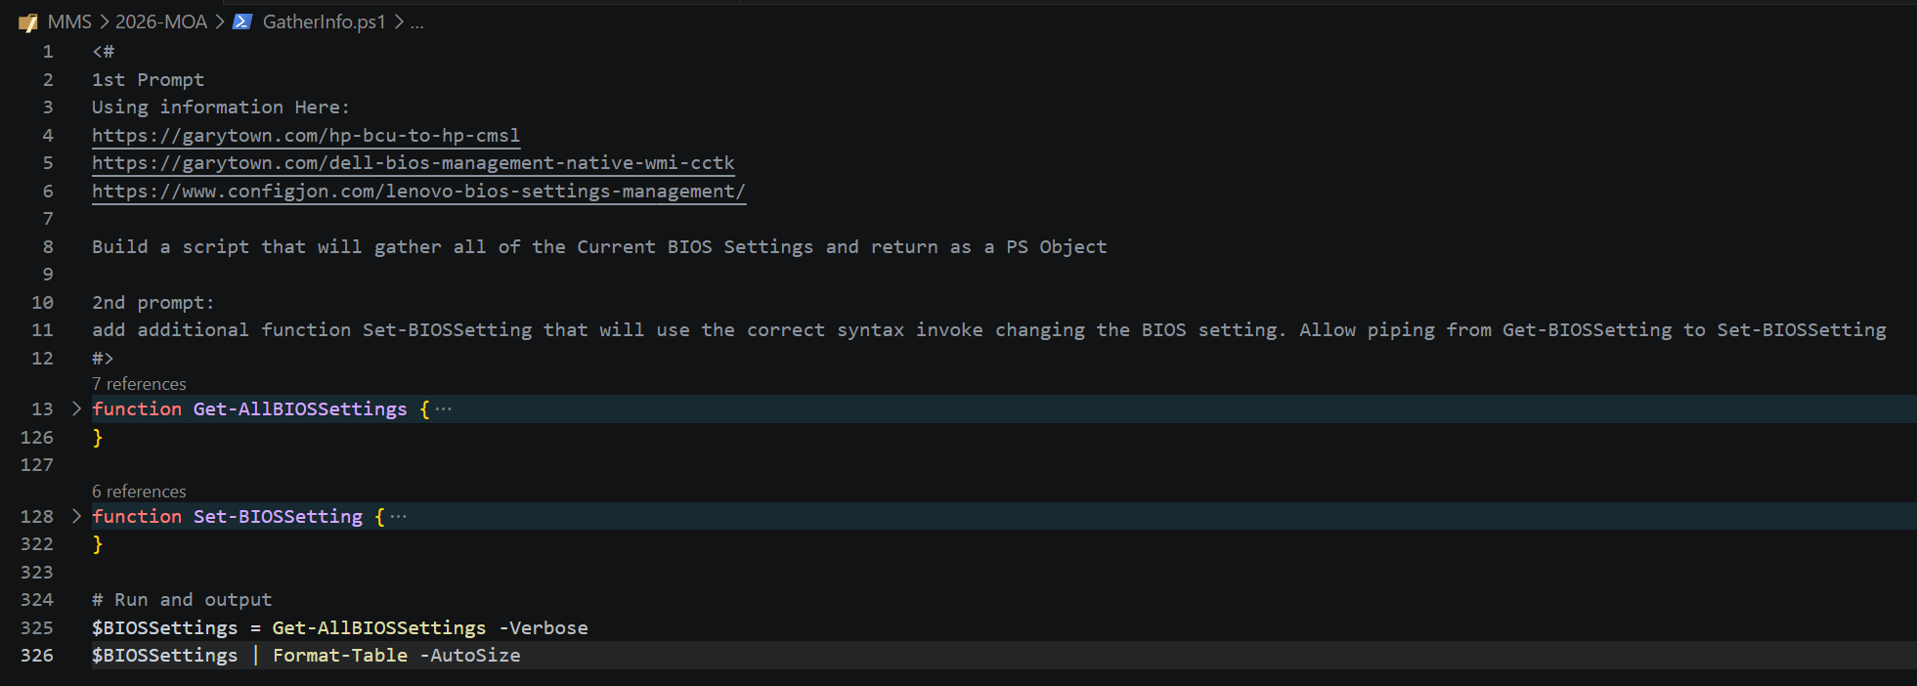
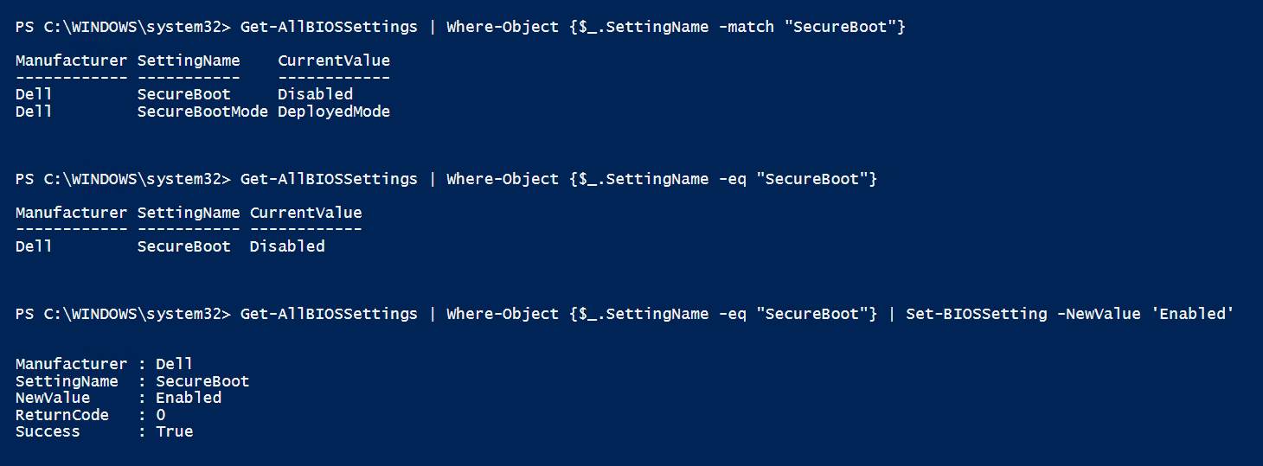

Slide 15
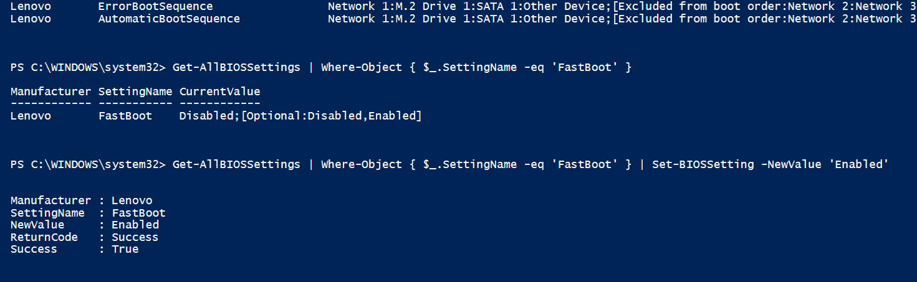
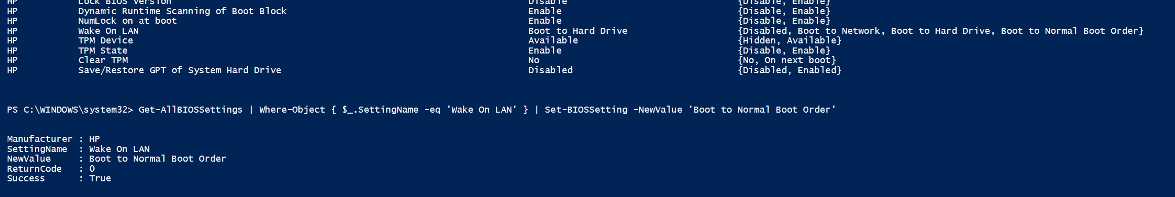
I noticed I didn’t know which values were options… so 3rd prompt, now list:

Slide 16
Tips – Testing different Agents
I’ve had pretty good luck with all of them… but sometimes things are… fishy
Just get stuck in trying to figure things out
Bizzarro code (has gotten much better over the past year)
My Go-To:

Slide 17
PowerShell to help Manage OEM Devices
Lenovo: ThinkVantage PowerShell Library
HP: Client Management Script Library
Dell: No module but has some stuff on GitHub
https://github.com/dell/Endpoint-Management-Script-Library
https://github.com/svenriebedell/Dell-Tools-Intune-Install
https://github.com/mkaptano/tools/
Panasonic: Deployment Support Tools
BIOS | Updates | PC Settings

Slide 18
OEM Modules – Modification
You don’t want to load an entire module to perform one or two functions? Great, lets create a script from the module…
DEMO time
Notes:
Build Demo of having VSCode look through Lenovo’s Module and built a script that will check for the latest BIOS, download and install it.

